Slide 1
DUAL AXIS SOLAR TRACKER
By ARMYS

Slide 2
Team Members
Yashwanth Gowda G.S. (captain) {physical assembly}
Arulanandan S {coding and project planning}
Mohan S {coding and calculations on design}
Rajneesh Ajay {circuit designing}
Soumik Nayak {circuit designing}

Slide 3
Objective
The aim of this project is to make an advanced solar tracking system for solar panel by using dual axis which gives flexibility to the rotation of solar panel and maximizing the power generation.
Efficiency- Generally a dual axis solar tracker has a performance gain of 25%. We are trying to increase it to 35-40% at the same cost.

Slide 4
The motivation from the project came from the social relevance of solar energy. Amid a global energy crisis, instruments such as solar panels need to be used to their highest potential. Therefore, there is a substantial need for methods that can optimize their energy collection. One of these methods is the use of solar tracking systems. These devices have become more utilized in the past decade, leading to several types of tracking systems. The hope for this project is to produce a fully operation, dual-axes, active solar tracker, that will improve upon the capabilities of the previous model.
Motivation

Slide 5
13th May 2022
01
27th May 2022
02
3rd June 2022
03
10th June 2022
04
14th June 2022
05
Work Plan
Deciding hardware requirements for project
Completed tinkercad simulation for the project
Decided the physical model for the project
Completed the necessary calculations for the design
Completed physical assembly of the project

Slide 6
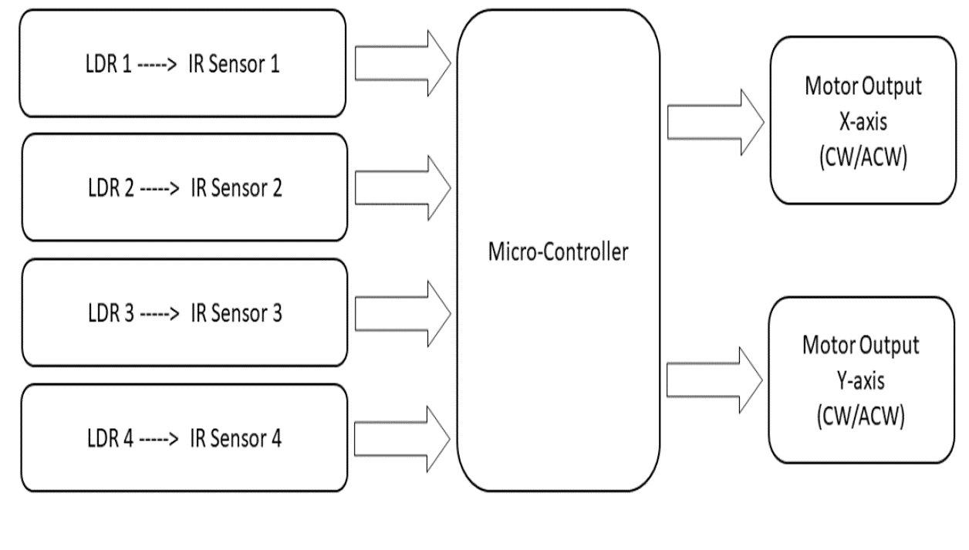
Schematic Diagram

Slide 7
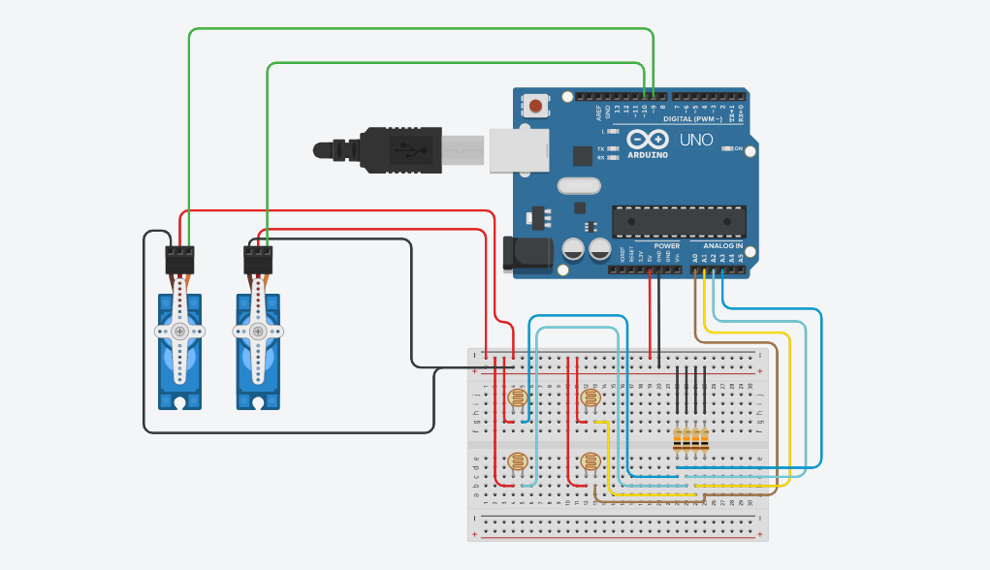
TinkerCAD Circuit Diagram

Slide 8
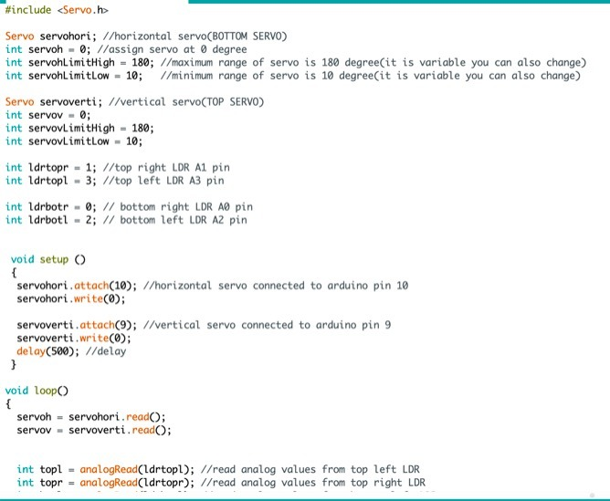
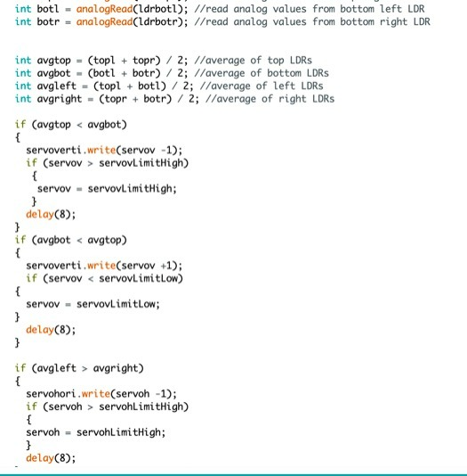
Code

Slide 9
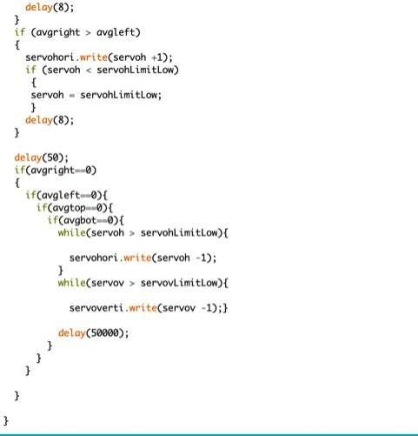

Slide 10
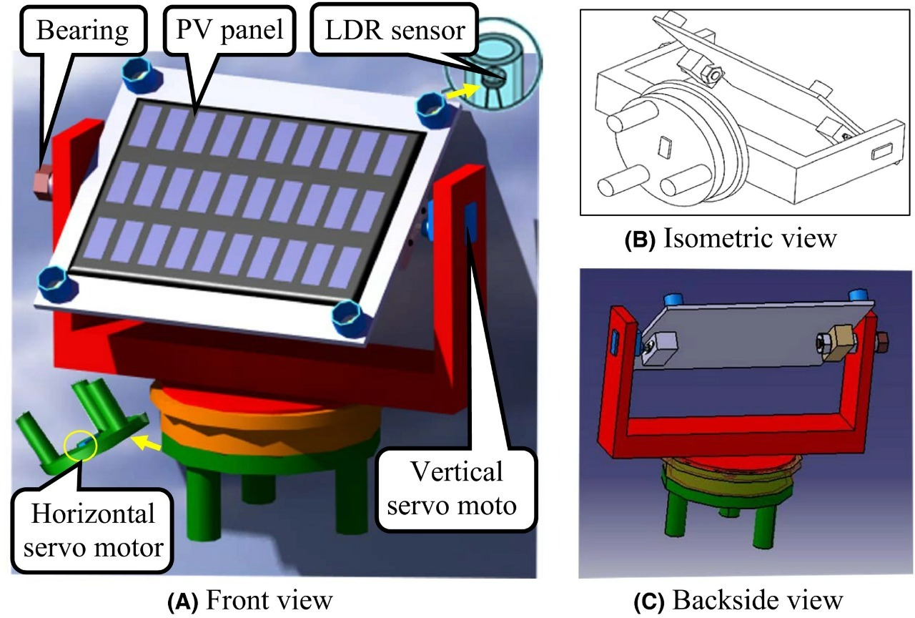
CAD design

Slide 11
Hardware
components
Items | cost
Arduino uno | Rs. 875
Servo motor | 2 * 375 = Rs. 750
Breadboard | Rs. 130
Ldr sensors | Rs. 25
Solar panels | Rs. 800
10 k ohm resistor | Rs. 20
Total | Rs.2600

Slide 12
Calculations
The required torque by motor = 1.914 kg-cm
Load on vertical servo = 100 g
Load of horizontal servo = 288 g
Power consumption by a servo = voltage*current
= 5 * 2 = 10 W
Total power consumption = 20W ( 2 servos)
Total power produced = 3.6 W ( 4 panels

Slide 13
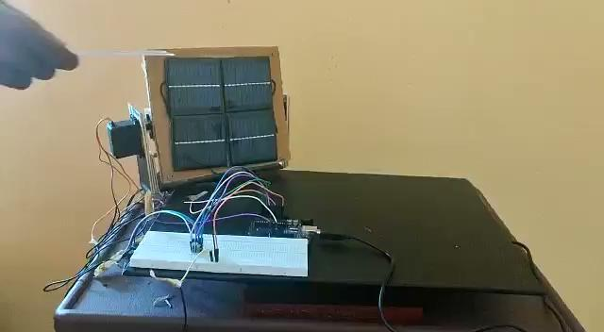
Video Explanation

Slide 14

Video Demonstration

Slide 15
Difficulties faced
In the assembling of the parts we placed difficulties in finding the right weight and thickness for the wooden frame.
Placements of ldr.

Slide 16
Insights Gained
Team work-We learned to coordinate among ourselves and work as a team
We learnt how to incorporate everyone into the work and finally perform the task in a time-oriented schedule.
Resource management-We had to use fundamental materials with limited resources
Acquisition of necessary skill set -It lead to a growth of our abilities related to circuits and coding a Arduino.We learnt about the solar panels and their potential to maximise power output.

Slide 17
Thank you

